Slide 1
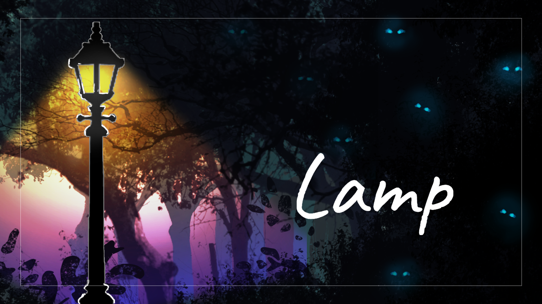

Cadrega Studio

Slide 2
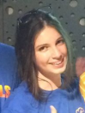
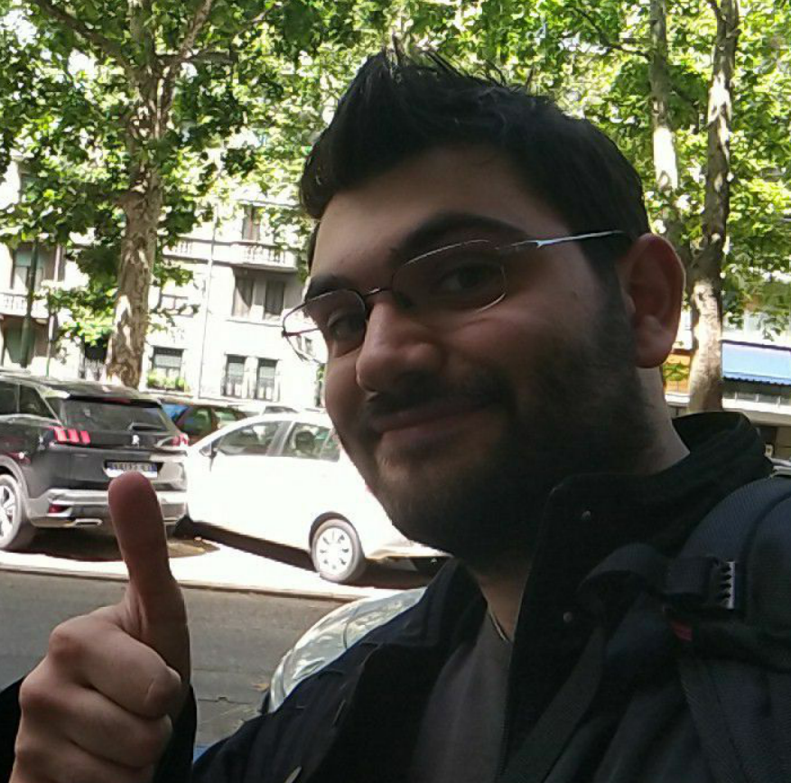
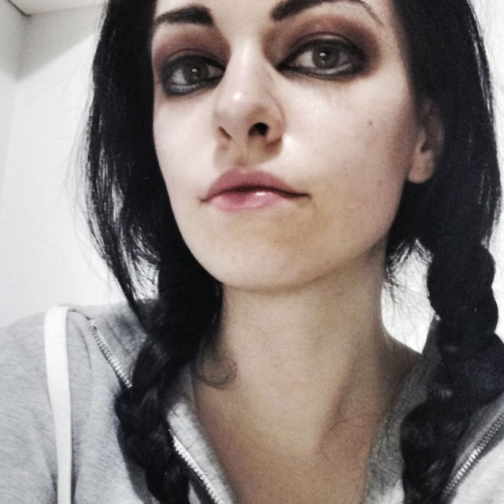
Development Team – Cadrega Studio
Francesca Bassi Game Designer
Game Programmer
Michael Daniel Naguib Game Programmer
Caterina Grasselli
Concept Artist
UI Artist

Slide 3
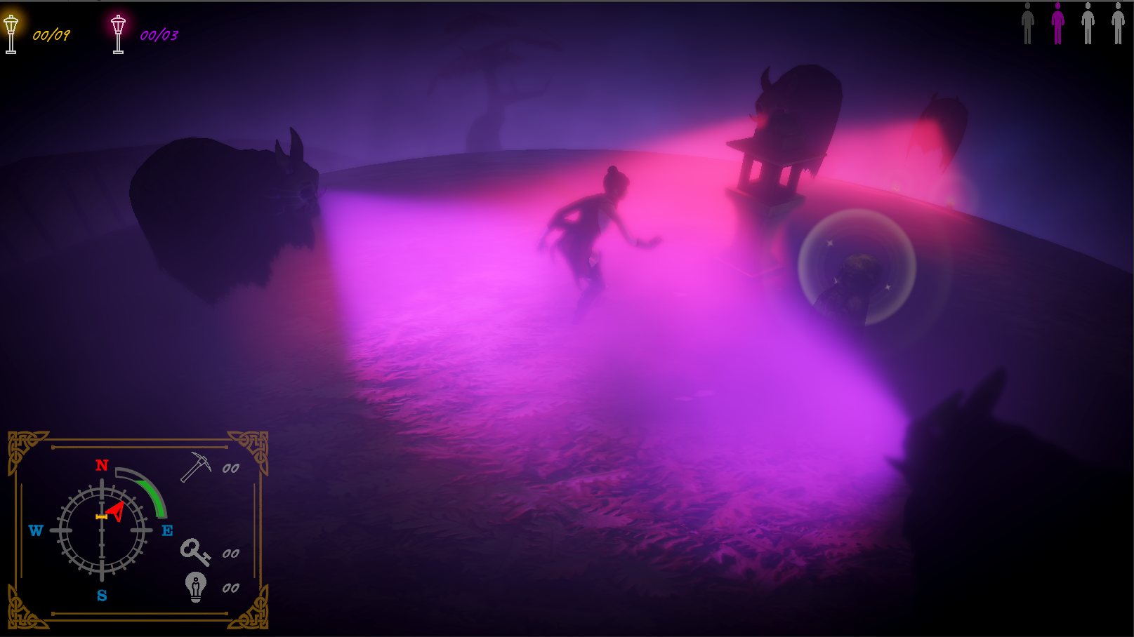
Game Overview - Lamp
Description:
Rekindle the magic lamps to defeat the curse and save the little planets!
Details:
Working title - Lamp
Genre – 3D Puzzle / Stealth
Gameplay time – 8 hours
Target consoles – Ps4, Pc, Switch

Slide 4
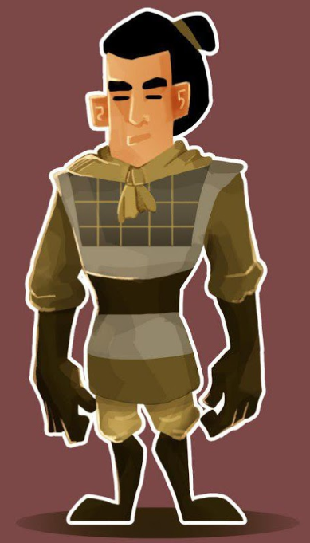
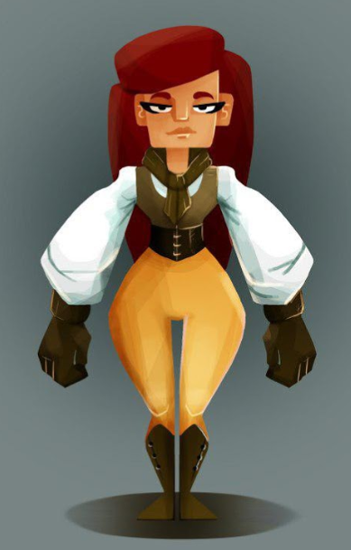
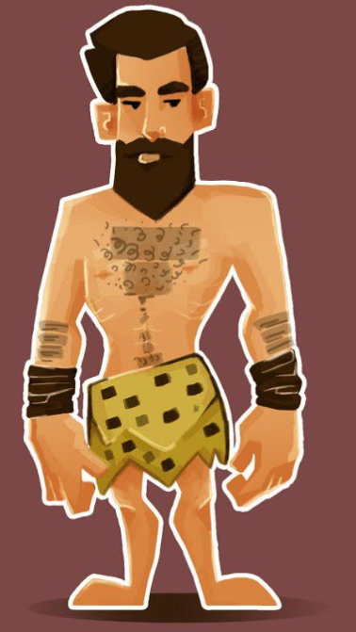
Story
A group of explorers gathered to save the universe from the curse, a dark mist that turns evil the inhabitants of the planets.
Travel around spherical levels in different historical periods, dodge the enemies corrupted by the curse and find the magic lamps to restore the light in every world.

Slide 5
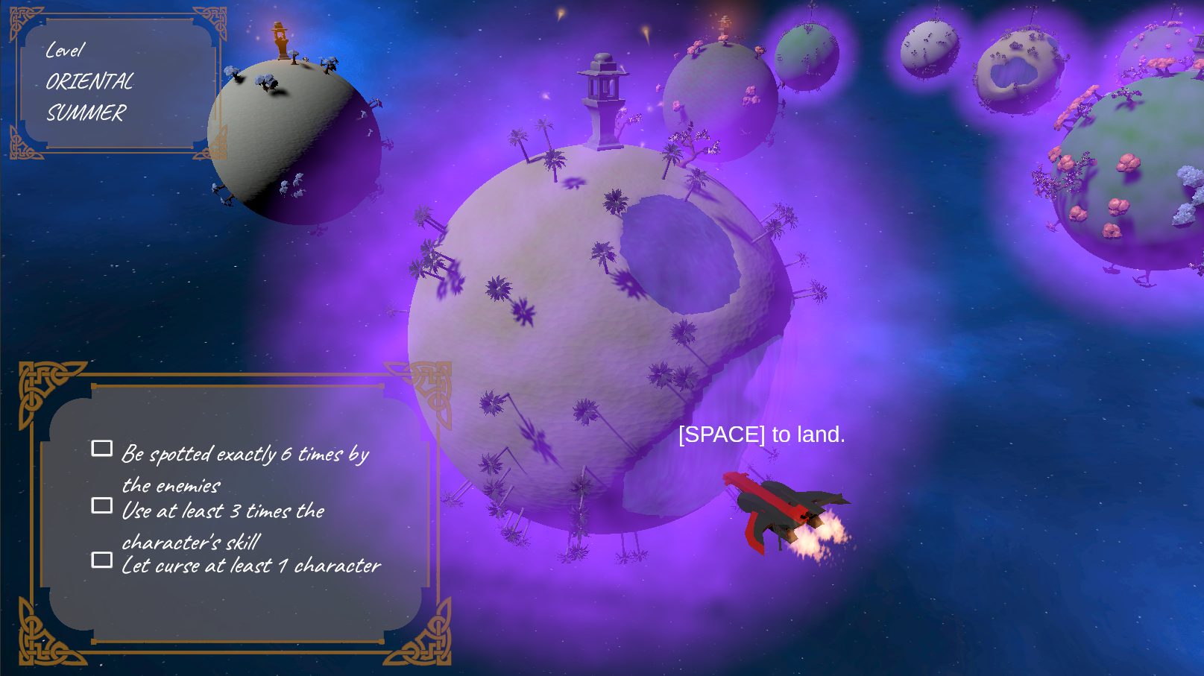
Replay Value
Replay
Challenges for each level
Unlock new characters
Use different composition of party
Various approach for each level
Extension
New Characters
New set of levels
New epochs

Slide 6
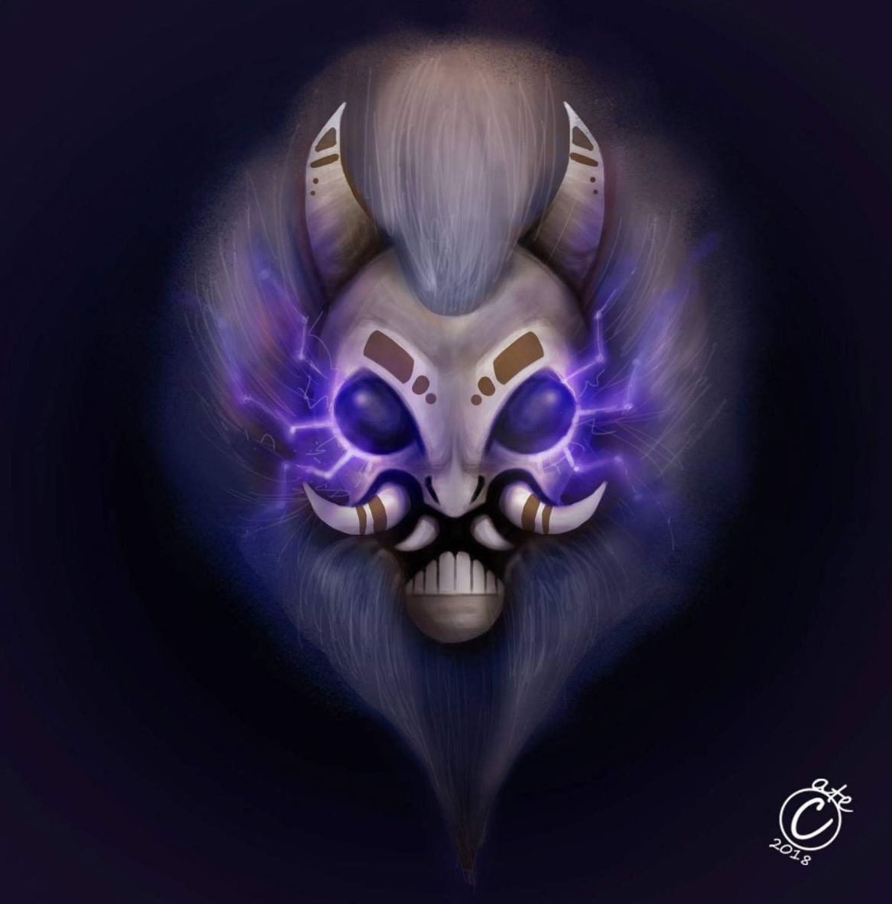
Unique Selling Points - USP
3D puzzle game on a 3D sphere
Environment puzzle (various terrain and obstacles)
Restore visibility while progressing the level
Unique characters with different abilities

Slide 7
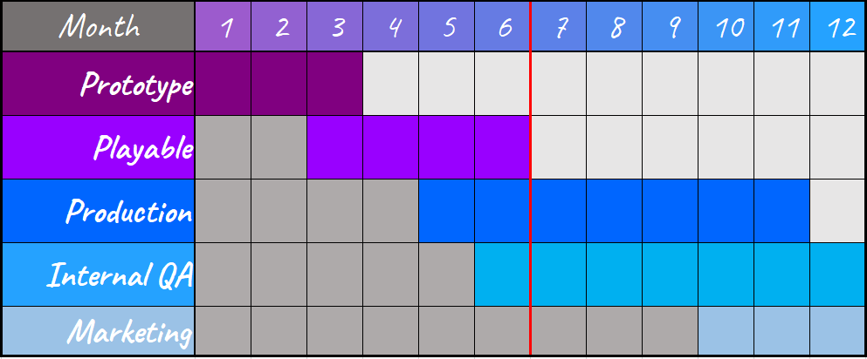
Budget and Schedule
6 more month of work: 120k€
Team needed:
3x programmer
2x artist

Slide 8
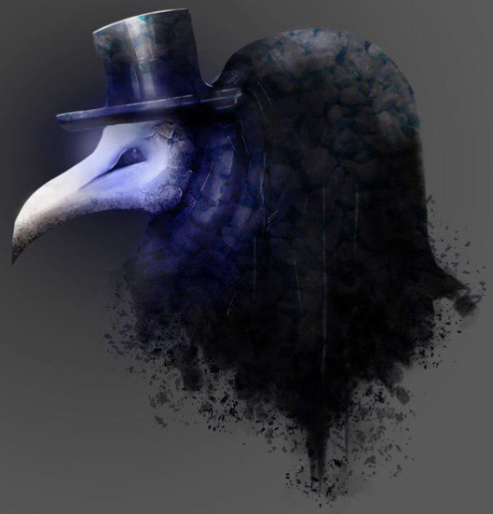
Summary
Stealth Puzzle game with environmental 3D puzzle on a sphere
Replayable elements
Possible extensions
150k€ to ultimate the project
6 month to ultimate the project
Target consoles are Ps4, Switch, Pc

Slide 9
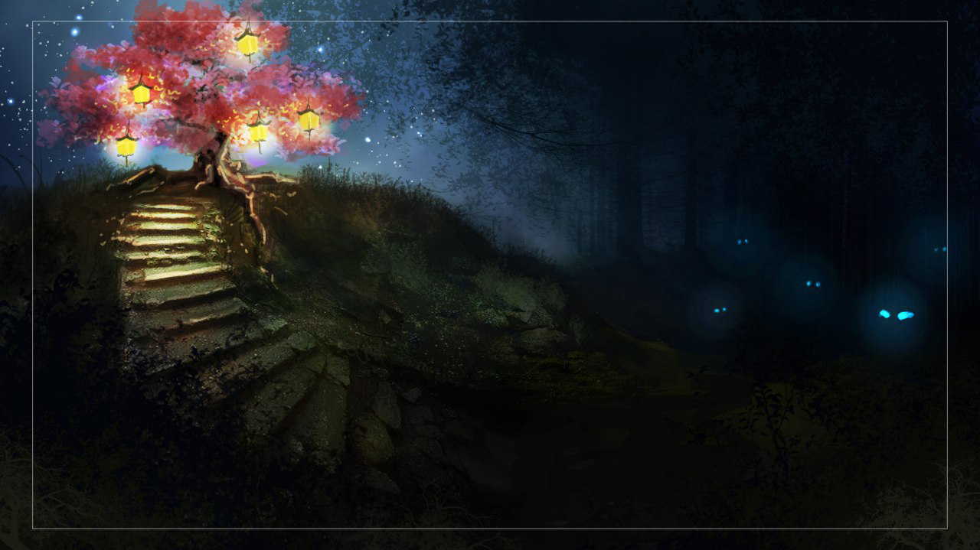

Lamp
Contacts
Francesca Bassi – Game Designer and Programmer
bassi.francesca95@gmail.com or francesca.bassi1@studenti.unimi.it
Michael Daniel Naguib – Game Programmer
michael.danielnaguib@gmail.com or michael.danielnaguib@studenti.unimi.it
Caterina Grasselli – Concept Artist and UI Artist
caterinagrasselli@gmail.com or cate_05@hotmail.it
Cadrega Studio

